Slide 1






Agho Fru & Katherine Halliday
Nov 29, 2023
BR41N_0V3RFL0W
MULTITHREADED SORTING: ENHANCING PERFORMANCE THROUGH CONCURRENCY
This presentation is optimized
for whiteboard use
Let's get started

Slide 2



AGENDA
Introduction
Project Overview and Design
Empirical Analysis and Findings
Summary
Tip: Use links to go to a different page inside your presentation.
How: Highlight text, click on the link symbol on the toolbar, and select the page in your presentation you want to connect.

Slide 3

INTRODUCTION
What is Multi-Threading?
Technique to improve performance by using multiple execution units (threads) to solve different parts of a problem simultaneously.
Benefits:
Enhanced Performance: Faster execution of parallelizable tasks.
Challenges:
Thread Locking: Conflicts when multiple threads access the same resource.
Overhead: Resource cost in creating and deleting threads.
Parallelization Limits: Not all tasks are suitable for parallel processing.
Key Takeaway:
Powerful tool for performance improvement, but requires careful management and is dependent on task suitability.
Back to Agenda Page

Slide 4


Back to Agenda Page
WHY SORTING
Ubiquitous in Computing: Sorting is a fundamental operation in computer science.
Search Optimization: Essential for making search algorithms faster and more efficient.
Real-World Applications: Underpins functionality in databases, search engines, and data analysis.

Slide 5



Project Design Overview: Assessing Multi-Threading on Sorting Algorithms
C++ Program: Executes each sorting algorithm 100 times.
Data Set: Uses an array of 10,000 statistically random numbers.
Multi-Threading Analysis: Measures performance impact when introducing multi-threading.
Thread Count Exploration: Observes diminishing returns with increased thread usage.

Slide 6
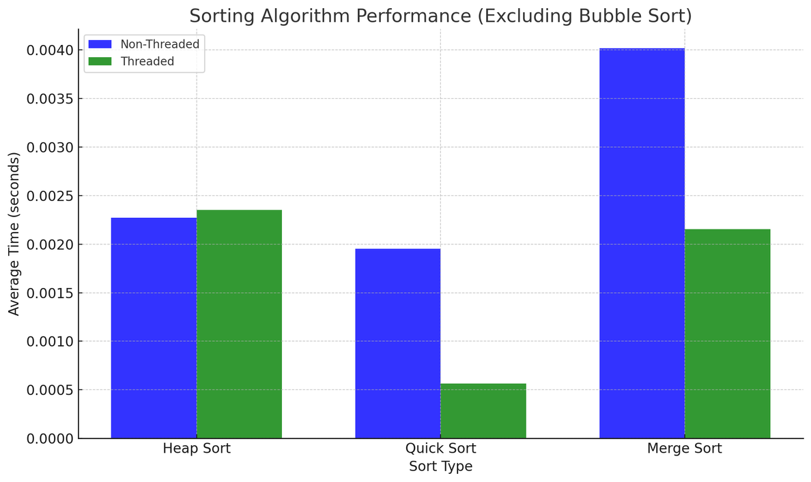

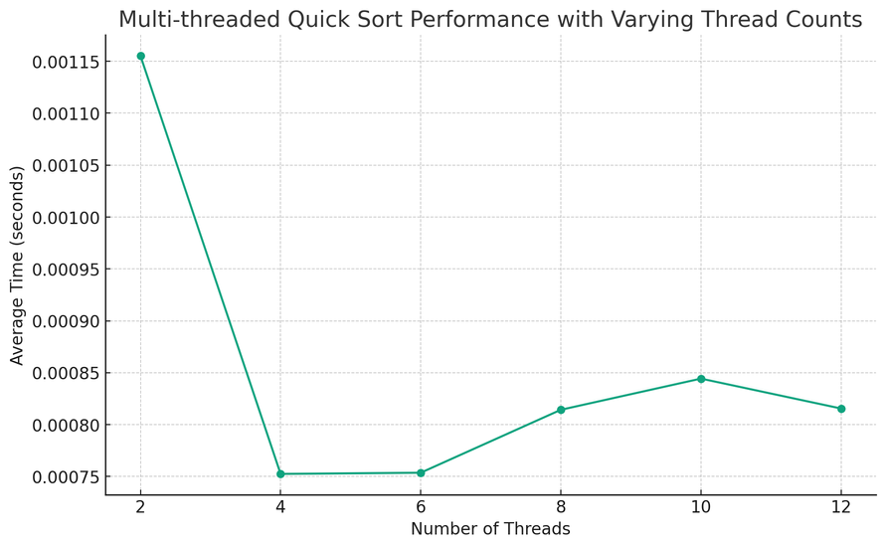
EMPIRICAL ANALYSIS AND FINDINGS
Performance Gains in Sorting Algorithms:
Quick Sort: 71.04% Speed Up
Merge Sort: 46.32% Speed Up
Heap Sort: No Speed Up
Reasons:
Limited Parallelization: Heap Sort's algorithmic structure offers fewer opportunities for efficient parallelization compared to Quick and Merge Sort.
Inherent Sequential Nature: Heap Sort relies on sequential heap operations, making it less amenable to multi-threaded improvements.
General Fallbacks of Multi-Threading:
Thread Management Overhead: Time and resources spent on creating, managing, and terminating threads can outweigh performance benefits.
Synchronization Issues: Thread locking and resource contention can lead to inefficiencies and deadlocks.
Non-Parallelizable Tasks: Some algorithms or tasks inherently do not benefit from parallel execution due to their sequential nature.
Key Takeaway:
While multi-threading can significantly speed up some algorithms, its effectiveness is highly dependent on the nature of the task and the algorithm's suitability for parallel execution.
Back to Agenda Page

Slide 7
Back to Agenda Page
SUMMARY
Multithreading Benefits:
Provides up to 4x performance boost in specific workloads.
Increases efficiency without a proportional rise in resource consumption.
Limitations:
Not all sorting algorithms benefit equally from parallelization.
Algorithmic structure and required procedural steps can limit multithreading effectiveness.
Project Conclusion:
Multithreading can significantly enhance sorting operations.
Its impact varies depending on the algorithm's nature and complexity.

